Slide 1
Desired State Configuration
Install & Configure SQL Server
Notes:
The PowerShell and DevOps Global Summit 2021

Slide 2

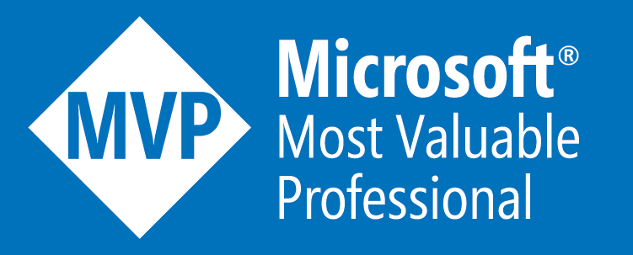

Jess Pomfret (She/Her)
@jpomfret
jpomfret7@gmail.com
Database Engineer
Open-Source Contributor
dbatools, dbachecks, SqlServerDsc
Crossfit & Proper Football

Slide 3
Agenda
Desired State Configuration
What?
Why?
How?
SQL Server + Desired State Configuration
Install
Configure
Change

Slide 4
Infrastructure as Code
Source Control
Build
Testing
Release Automation
Notes:
First off – why use DSC?
DSC gives us a framework to enable Infrastructure as Code
IaC – basically all our infrastructure is described as code – how to build a VM is a file that says VM1 has 2 CPUs, 8GB of RAM, OS, File system layouts, SQL Server is configured with these settings
Benefits
- repeatable
- security – minimize permissions needed
- changes to servers are documented
- role changes through environments – dev→test→prod
- easy to change 100 servers
- consistency across environments, don’t have snowflakes
IaC means that your build server/CI pipeline does need to be secure – holds the keys to your kingdom
Organizational culture/change – start small with a project, expand after that

Slide 5
What is Desired State Configuration?
First released in WMF 4.0
Enhanced with WMF 5.1
DSC for PowerShell 7 – future enhancements…
PowerShell - Domain-specific language
Create Configurations
Manage the ‘desired state’ of our infrastructure
Notes:
WMF – Windows Management Framework
https://docs.microsoft.com/en-us/powershell/scripting/windows-powershell/wmf/whats-new/dsc-improvements?view=powershell-7.1
More enhancements coming
Goal for DSC to be cross platform
Domain specific language - DSC/Pester
- own domain of terminology and patterns to describe things
- HTML, CSS, Pester
https://powershellexplained.com/2017-02-26-Powershell-DSL-intro-to-domain-specific-languages-part-1/
-- ignore -
Based on industry standards, using MOF and CIM

Slide 6
DSC Stages
Author
Publish
Enact
Monitor
Notes:
https://blogs.msdn.microsoft.com/powershell/2013/11/01/configuration-in-a-devops-world-windows-powershell-desired-state-configuration/
Author – write configuration document – describing your desired state in declarative syntax
Publish – Distribute the configuration document to each node
Enact – Local Configuration Manager on each node applies the configuration
Monitor – LCM monitors for configuration drift, can automatically fix it
DSC available from Windows 8.1 and Windows Server 2012 R2.
Prior to this install WMF 4.0 – or now improved 5.1

Slide 7
Step 1: Author

Slide 8
Declarative Vs Imperative
Declarative
File CreateDataDir {
DestinationPath = 'C:\temp'
Ensure = 'Present'
Type = 'Directory'
}
Imperative
New-Item –Path 'C:\temp' –ItemType Directory
Notes:
Imperative – explaining the steps to complete the task
Declarative – describing the end state you want
Declarative – makes authoring and maintaining the configuration easier.
- DSC has no need for error handling in your scripts – the DSC framework handles that
Idempotent – define the desired state, no matter the current state. If the directory exists it will be in desired state so stop. The Imperative script will fail trying to create a new directory unless you add logic.

Slide 9
Idempotent
“Idempotence is the property of certain operations in mathematics and computer science whereby they can be applied multiple times without changing the result beyond the initial application.”
- Wikipedia
Notes:
Can apply the same configuration more than once. Whatever the current state, it will end up in the desired state.
Don’t have to roll your own logic/error handling.
Can make incremental changes to a configuration document and redeploy.

Slide 10
Resources
Building blocks of our configurations
Types
Script Based
Class Based
Write your own
Notes:
Script based
- don’t include metadata so there is an extra MOF schema file that defines that
Class based
- future state – only supported type as it removes dependency on MOF schema file → Cross platform
- inherit base classes so helper functions, methods don’t need to be duplicated

Slide 11
Demo: Resources
Get-DscResource -Module PSDesiredStateConfiguration
Get-DscResource -Name File –Syntax
File [String] #ResourceName
{
DestinationPath = [string]
[Attributes = [string[]]{ Archive | Hidden | ReadOnly | System }]
[Contents = [string]]
[Credential = [PSCredential]]
[DependsOn = [string[]]]
[Ensure = [string]{ Absent | Present }]
…
}
Find-DscResource -Name SqlSetup
Notes:
Resources are implemented as Modules
Each Resource has a Get-, Test-, Set- Function within
Or Get, Test, Set method for class based
Get-DscResource on a class based resource? Does it change?

Slide 12
Resources – Additional
PSDesiredStateConfiguration
PSDscResources
File
SqlServerDsc
SqlAg
SecurityPolicyDsc
AccountPolicy
Archive
Service
ServiceSet
User
WindowsFeature
WindowsFeatureSet
SqlAgentOperator
SqlDatabase
SqlDatabaseOwner
SqlScript
SqlServerLogin
SqlServerMemory
SqlSetup
Script
SecurityOption
SecurityTemplate
UserRightsAssignment
*This is just a sample of resources from each module
Notes:
(Find-DscResource).count – gets the number of resources in the gallery
3/8/2019 – 1,406
6/4/2019 – 1,485
7/16/2020 – 1,753
2/4/2021 – 1,859
PSDscResources – combination of the resources within PSDesiredStateConfiguration and from experimental module xPSDesiredStateConfiguration
- ServiceSet & WindowsFeatureSet – Composite resources – Pass in multiple features and it translates it to use the WindowsFeature resource for each one.
SqlServerDsc has 41 resources
SecurityPolicyDsc – wrapper around secedit.exe to configure local security policies
Perform_volume_maintenance_tasks
Lock_pages_in_memory
Log_on_as_a_service

Slide 13
DSC Configuration
Configuration CreateSqlFolders {
Import-DscResource -ModuleName PSDesiredStateConfiguration
Node Server1 {
File CreateDataDir {
DestinationPath = 'C:\SQL2017\SQLData\’
Ensure = 'Present’
Type = 'Directory’
}
}
}
Notes:
Configuration (command type)
a special type of PowerShell function.
Named CreateSqlFolders
Import-DscResource (keyword)
Can only be used within Configuration block
Import any needed resources
Can use –Name to get a specific resource – will pick first one it finds with that name and is intensive if you have a lot of modules. Recommended to use –ModuleName and -Name
Node block
One or more node blocks
Defines the target node
Array notation to pass in multiple. Node @('localhost', 'Server01’)
Resource block
One or more resource blocks
Calling the File resource
Named CreateDataDir
Properties to define our desired state for the resource
https://docs.microsoft.com/en-us/powershell/dsc/configurations/configurations
https://docs.microsoft.com/en-us/powershell/dsc/configurations/import-dscresource

Slide 14
MOF Files
Configuration gets compiled into a MOF file
One MOF per node (except partial configuration)
Can be modified & reapplied

Slide 15
Demo: Create a MOF
Create a simple configuration
Invoke the configuration to create the MOF file

Slide 16
Enhance #1: Configuration data
Separate ‘data’ from ‘configuration’
Define data to use within the Configuration
Use the same Configuration for dev/test/prod
ConfigurationData Common Parameter
Pass in a hashtable
Must have an AllNodes key
$MyData =
@{
AllNodes = @()
NonNodeData = ""
}
Notes:
Data like server names, folder paths
Data can be different for each environment
Use the same DSC configuration – use the configuration data to customize per environment
Configuration can be a separate psd1 file

Slide 17
Demo: Configuration Data
Enhance our configuration
Separating data from code
Different configurations based on Environment
Move configuration data to separate file

Slide 18
Enhance #2: Composite Resources
Real world configurations can become long and complex
Break configurations into chunks → composite resources
Parameters
Support PsDscRunAsCredential
Notes:
Parameters – can be used in composite configurations the same as you would in functions
- pass in values to be used for variables
- parameters then act as properties for the resource when you call it
PsDscRunAsCredential – allows you to run resources under a certain credential that is passed in
Default is to run as the system account – which might not have access to user registry keys, file share access

Slide 19
Demo: Composite Resources
Enhance our configuration
Create composite resources from chunks
Main config is simplified by calling composite resources
Use parameters to control behaviour of composite resources

Slide 20
Step 2: Publish

Slide 21
DSC Mode
Push
Start-DscConfiguration – user applies configuration
Configuration applied immediately
Node checks pull service for configurations
Default refresh mode
Pull
RefreshFrequencyMins – how often node checks
Use local service, SMB share, Azure Automation
Notes:
https://docs.microsoft.com/en-us/powershell/dsc/pull-server/enactingconfigurations

Slide 22
Start-DscConfiguration
Delivers Configuration to node(s)
Enacts Configuration – “Makes it So”
Start-DscConfiguration -Path .\output\ `
-ComputerName dscsvr2 `
-Wait `
-Verbose

Slide 23
Publish-DscConfiguration
Delivers Configuration to node(s)
Doesn’t apply the configuration
Publish-DscConfiguration -Path .\output\ `
-ComputerName dscsvr2 `
-Verbose

Slide 24
Step 3: Enact

Slide 25
Local Configuration Manager
DSC Engine
Runs on target nodes
Parses & Enact
Determines refresh mode
Configure using meta configuration

Slide 26
LCM Settings
ActionAfterReboot
CertificateID
ConfigurationMode
ConfigurationModeFrequencyMins
RebootNodeIfNeeded
RefreshMode
RefreshFrequencyMins
Notes:
https://docs.microsoft.com/en-us/powershell/dsc/managing-nodes/metaconfig
ActionAfterReboot – what to do after a reboot: ContinueConfiguration, StopConfiguration
CertificateID – Thumbprint of certificate to secure credentials in the MOF
ConfigurationMode "ApplyOnly","ApplyAndMonitor", and "ApplyAndAutoCorrect".
ConfigurationModeFrequencyMins – how often current configuration is checked & applied. Timer restarted when a metaconfig is applied or a system restart
RebootNodeIfNeeded – node will be rebooted if required by configuration
RefreshMode – Push, Pull
RefreshFrequencyMins – time interval at which LCM checks pull service for updated configurations.

Slide 27
Demo: LCM Meta Configuration
## Get Current settings
Get-DscLocalConfigurationManager -CimSession dscsvr2
## Apply configuration
Set-DscLocalConfigurationManager -Path .\output\
-ComputerName dscsvr2 -Verbose

Slide 28
Step 4: Monitor

Slide 29
Demo: Configuration Reporting
## Get the current configuration of the nodes
Get-DscConfiguration -CimSession dscsvr2
## Get configuration status for completed runs
Get-DscConfigurationStatus -CimSession dscsvr2 |
Select-Object *
## Test the current configuration
Test-DscConfiguration -ComputerName DscSvr2 -Verbose
Notes:
This could be a whole session in itself
These commands will get you started
Note:
Test-configuration –verbose… see where it failed.
Stops at first failure

Slide 30
DSC Event Logs
Event Viewer
Application and Services Logs > Microsoft > Windows > Desired State Configuration
Operational
Admin
Analytic
Debug
Notes:
Analytic & Debug not enabled by default

Slide 31
DSC & Sql Server

Slide 32
Install SQL Server
Install Windows Features - .NET Framework
Create directories for Install/Data/Logs/Tempdb
Install SQL Server
Enable TCP/IP
Set Windows Firewall
Server Configuration Options (sp_configure)
Backup compression
CTOP
MAXDOP
Create DBA Database

Slide 33
Step | Module | DSC Resource
1) Install Windows Features | PSDesiredStateConfiguration | WindowsFeature
2) Create directories | PSDesiredStateConfiguration | File
3) Install SQL Server | SqlServerDsc | SqlSetup
4) Enable TCP/IP | SqlServerDsc | SqlServerNetwork
5) Windows Firewall | SqlServerDsc NetworkingDsc | SqlWindowsFirewall Firewall
6) Server Configuration | SqlServerDsc | SqlConfiguration
7) Create DBA Database | SqlServerDsc | SqlDatabase

Slide 34
Demo: Install SQL Server
Install & Configure SQL Server
Make a change & reenact

Slide 35
Next Steps
Source control
CI Pipeline
Pull Server\Azure Automation
Third Party Integration (Chef, Puppet, Ansible, etc.)
Datum\DscWorkshop
Azure Automation
Notes:
Chef - infrastructure Automation framework – Ruby – write recipes
Datum - Composite configurations
DscWorkshop – blueprint project using Datum to generate everything you need for push or pull setups
Azure Automation
- built in pull server
- Easily manage DSC Artifacts – Configurations, Resources, Target Nodes
- Send reporting data to Azure Monitor Logs

Slide 36
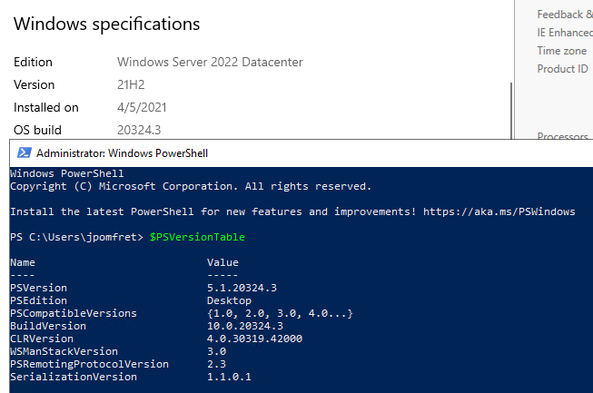
What’s next for DSC?
PowerShell 7 \ DSC V3
Invoke-DscResource
Remove dependency on MOF
Class based resources
No LCM?
Timeline?
Notes:
DSC was originally built on top of WMI which means its windows only
PowerShell 7.1 – started making it cross platform
- Invoke-DscResource to directly use resources without the LCM
- removing dependency on MOF
- currently there are two dependencys
– schema files for script based resources – therefore only will support class based resources
- mof file that is delivered to target node and enacted by LCM – no LCM?
Timeline – is listed on the ‘PowerShell Team 2021 Investments’
PowerShell Team 2021 Investments | PowerShell Team (microsoft.com)
Windows 2022

Slide 37
Questions?
Jess Pomfret
jpomfret7@gmail.com
@jpomfret
www.JessPomfret.com
https://github.com/jpomfret/demos/

